Slide 1
Mentoring Families
out of Homelessness.

Slide 2

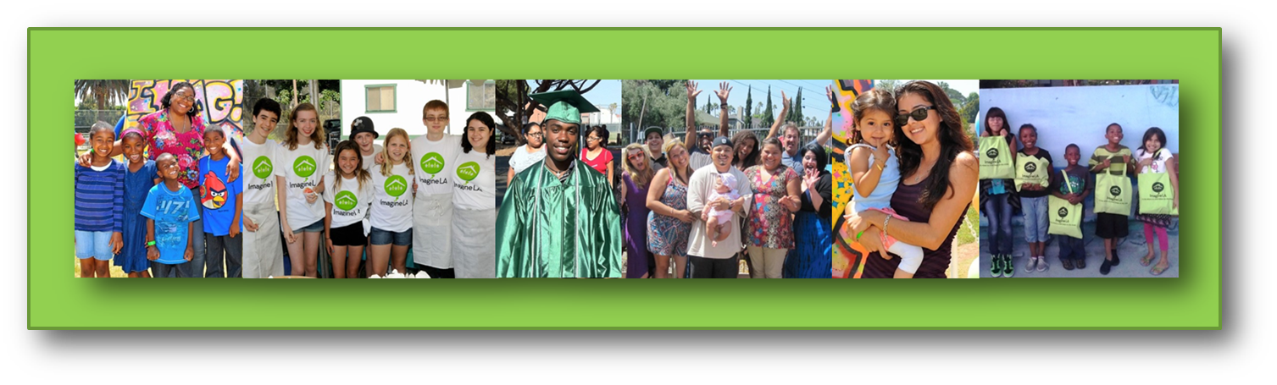
Mission
Imagine LA ends the cycle of family homelessness by mobilizing trained mentors, public and private resources, and community leaders who understand that a roof over one’s head is merely the starting point to a better life.

Slide 3
Family Empowerment & Mentorship Model
1
2
3
Mentorship
One-on-One mentor for every family member 5+ years
Financial Wellness mentor for every family
Other volunteers: tutoring, health, meal-planning, and more
Clinical Case Management
5-hour mentorship training
Ongoing guidance with your Family Team Manager via weekly conference calls
Guided framework for the mentoring process
Quarterly Family & Team meetings
Access to Resources
Private Resources
Fun Events and Activities
Non-Profit Partner Organizations
Government Agencies

Slide 4





Our Families
Who are our Families?
  50% have experienced intimate partner violence
  45% have been diagnosed with a mental illnesses
  36% are recovering from substance use disorders
  Many children have special needs
  Over 90% are single parent households
  All are motivated, resilient, and have decided that mentorship is right for them and their family!
How are our Families referred?
  Referral Partners: Transitional Housing Shelters, Permanent Supportive Housing, & Family Solution Centers
Where do our Families live?
  Scattered-site housing around Los Angeles
  Permanent Supportive Housing in South LA (ACOF) and Koreatown (St. Anne’s)
  What is an ideal family for the Imagine LA program?
  Willing and excited to work with a mentor team
  Willing and excited to set and meet goals (wellness, employment, income, education, etc.)
  Meet all Imagine LA program requirements

Slide 5
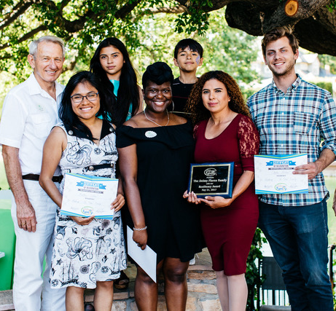
Our Volunteers
Where do our Volunteers come from?
  Local Businesses
  Faith Communities
  Corporations
  Groups of Friends
  Individuals
If you are interested in an immersive, impactful volunteer experience, then this is your opportunity to:
  Interrupt the cycle of homelessness and poverty on a deeper level
  Witness the impact of your work as a mentor
  Create long lasting relationships

Slide 6
Mentor Team Structure
Family Team Manager
(Staff)
Team Liaison
(Dual role )
Tutor/Educational Support
Health/Wellness Team
Special Projects Team
One-on-One Mentors
(Biweekly meeting and weekly check-ins)
Financial Wellness Mentor
(Biweekly, then once/month)
As needed
12 – 18 months
Full Time
TEAM SIZE DEPENDS ON FAMILY’S SIZE AND NEEDS

Slide 7
Natural Support System Framework
Natural supports are essential to help Families thrive. They promote independence and growth in addition to creating an environment that fosters creativity and confidence. Natural supports help Families develop deep, meaningful relationships full of mutual respect, love, and laughter. These relationships allow Families to begin the process of moving away from reliance on social service agencies and toward reliance on self, friends, family, and the community. Mentorship promotes community and the building of natural supports. For this reason, Imagine LA developed the Natural Support System Framework – a framework aimed at helping you and your mentee Family grow over the next 12 – 18 months.

Slide 8
Natural Support System
Phase 1
Family
Mentor Team
Family Team Manager
(FTM)
Phase 2
Family
Phase 3
Family & Natural Support System
Social Services
Social Services
Community
Mentors
FTM
Goals
Goals
Community
Build
Enhance
Uphold

Slide 9
Desired Outcomes
To maintain permanent housing
To demonstrate heightened financial literacy and increase earned income
For youth to finish high school and attend college or vocational school
For families to receive annual medical and dental exams
For non-school-aged children to meet age-appropriate developmental standards
For families to report improved conflict resolution skills within the family unit

Slide 10
How do I refer a family?
Determine family’s eligibility (see eligibility form).
Fill out Imagine LA Referral Form.
Scan and email referral form to diana@imaginela.org with the word REFERRAL in email subject line.
The assigned Family Team Manager will contact you within three business days to complete any missing information and/or provide a referral receipt.

Slide 11
Contact Us
Diana Salazar
Associate Executive Director
diana@imaginela.org
323-944-0210 x1002
or
Ciera Thornton
Program Coordinator
ciera@imaginela.org
323-944-0210 x1005

