Slide 1
CORE HIV MEDICAL SERVICES
FOR PERSONS LIVING WITH HIV
RFP No. 2024-008
Proposer’s Conference
September 11, 2024
St. Anne’s
155 N. Occidental Blvd,
Los Angeles, CA 90026

Slide 2

Welcome and Introductions
CORE HIV MEDICAL SERVICES FOR PERSONS LIVING WITH HIV RFP No. 2024-008 Proposer’s Conference
Mandy Leung, Contract Analyst
Division of Contracts and Grants
County of Los Angeles Department of Public Health

Slide 3

Agenda
  Conference Guidelines and Housekeeping
  Proposer’s Conference Overview
  Director’s Remarks
  Associate Medical Director’s Remarks
  Overview of Services
  Overview of Program and Technical Requirements
  Selection Process and Evaluation Criteria
  Q & A Session
  RFP Timeline – Next Events
  Proposal Submission Guidelines
  Conclusion

Slide 4
Conference Guidelines and Housekeeping
Each agency representative must check-in and sign/complete the conference attendance sign-in sheet
Recording and/or video taping of the conference is not permitted. All attendees must put electronic devices (cellphones, etc.) on “silent” mode during the conference. If you need to take a call, please step out into the hallway
If submitting a written question, please print legibly when completing the question cards. The facilitator will collect the question cards before the break.
County staff will respond to questions during the Q&A session; however, those questions that require further research and/or discussion will be deferred and released in the subsequent Q&A Addendum on October 1, 2024.

Slide 5
Proposer’s Conference Overview
Conference Goals
  Provide Proposers insight into the rationale and need for the requested services
  Provide overview of the services
  Review technical requirements to assist Proposers in developing their proposals
  Allow for questions from Proposers regarding the RFP and associated documents and/or process
r

Slide 6
Director’s Remarks
Mario J. Pérez, MPH
Director
Division of HIV and STD Programs (DHSP)
County of Los Angeles Department of Public Health

Slide 7
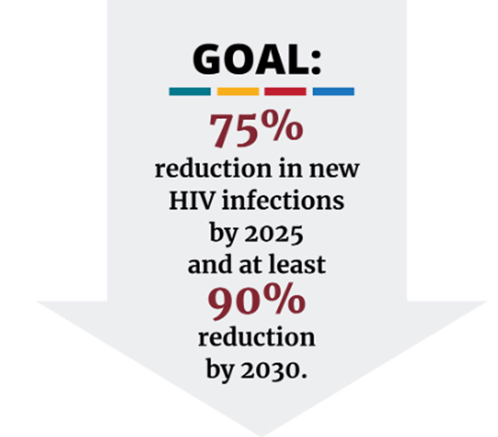
Ending the HIV Epidemic
The goals of the national initiative, Ending the HIV Epidemic (EHE): A Plan for America, of reducing HIV by 75% by 2025 and 90% by 2030 can not be achieved without your partnership, new approaches, and more responsive systems of care, treatment and prevention.

Slide 8
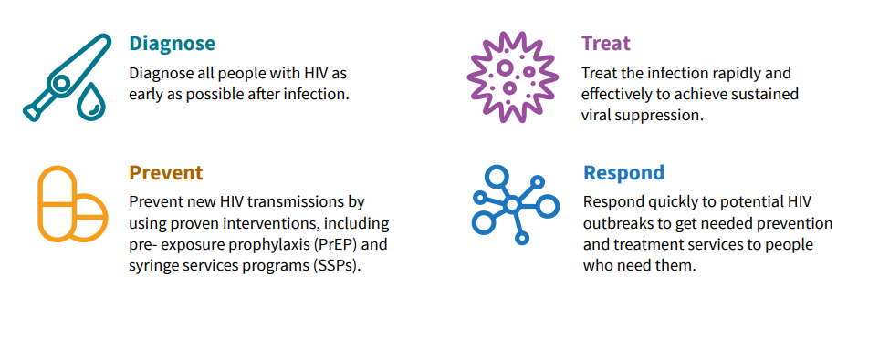
EHE Strategies

Slide 9
Epidemiology of the Syndemics in Los Angeles County
As of year-end 2023, there were 51,778 persons with diagnosed HIV (PLWDH) in LAC aged 13 years and older.
In 2022, 1,641 persons aged 13 years and older were newly diagnosed with HIV.
51,778
People with HIV
in LA County
1,641
new HIV diagnoses in LA County
Division of HIV and STD Programs, Department of Public Health, County of Los Angeles. HIV Surveillance Annual Report, 2023. Pending publication http://publichealth.lacounty.gov/dhsp/Reports.htm

Slide 10
Epidemiology of the Syndemics in Los Angeles County
Over the past decade, there has been a decline in HIV diagnosis rates among males, while rates among females have remained stable
Division of HIV and STD Programs, Department of Public Health, County of Los Angeles. HIV Surveillance Annual Report, 2023. Pending publication http://publichealth.lacounty.gov/dhsp/Reports.htm

Slide 11
Purpose of Request for Proposals (RFP)
To solicit proposals from interested and qualified Proposers throughout Los Angeles County (LAC) to provide Core HIV Medical Services for Persons Living with HIV (PLWH) comprised of:
Ambulatory Outpatient Medical (AOM) Services,
Medical Care Coordination (MCC) Services , and
Patient Support Services (PSS)

Slide 12
Medi-Cal Expansion and Core HIV Medical Services
Medi-Cal expansion broadens eligibility criteria and benefits to cover more people, including those living with HIV, and provides full healthcare coverage.
Despite some clients being hesitant to migrate to Med-Cal, our services are payer of last resort. Eligible clients MUST be moved onto a Medi-Cal plan for medical services, but may benefit from other services supported by DHSP.

Slide 13
Associate Medical Director’s Remarks
Becca Cohen, MD, MPH
Associate Medical Director
Division of HIV and STD Programs (DHSP)
County of Los Angeles Department of Public Health

Slide 14
Celebrate Our Successes
PLWH in Los Angeles County (2022) and RWP Clients (RWP Year 32)
Division of HIV and STD Programs, Department of Public Health, County of Los Angeles. HIV Surveillance Annual Report, 2022.
DHSP, Casewatch, Years 23-33; DHSP, HIV Surveillance data 2013-2022, as of July 2022

Slide 15
Celebrate Our Successes
Improvement in Key Outcomes 12m Pre- and Post-MCC, 2013-2022 (N=14,281)
Patients enrolled in MCC experienced significant improvements in retention in care and viral suppression
*p<0.01. Data source: DHSP, Casewatch, Years 23-33; DHSP, HIV Surveillance data 2013-2022, as of July 2022
Notes:
An increase over 35% in the proportion of patients retained in care from pre- to post-MCC
An increase over 60% in the proportion of patients virally suppressed from pre- to post-MCC
MCC was effective in improving viral suppression and retention in care at 12 months among patients at safety net HIV clinics

Slide 16
Celebrate Our Successes
Linkage to care in 7 days among patients served at Rapid Treatment Hubs
Division of HIV and STD Programs, Department of Public Health, County of Los Angeles. HIV Surveillance data accessed April 2024.

Slide 17
Focus on opportunities for improvement
Viral Suppression among AOM clients, Years 29-33
Division of HIV and STD Programs, Department of Public Health, County of Los Angeles. HIV Surveillance Annual Report, 2022.
DHSP, Casewatch, Years 23-33; DHSP, HIV Surveillance data 2013-2022, as of July 2022

Slide 18
Focus on opportunities for improvement
Change in Viral Suppression 12m Pre- and 12m Post- MCC, 2013-2022
Division of HIV and STD Programs, Department of Public Health, County of Los Angeles. HIV Surveillance Annual Report, 2022.
DHSP, Casewatch, Years 23-33; DHSP, HIV Surveillance data 2013-2022, as of July 2022

Slide 19
Support flexible and agile services
  AOM
    Rapid services, “no wrong door,” and working with Medi-Cal eligible but not (yet) enrolled clients via 60-day grace period
  MCC
    Updated (shorter) assessment, fewer required reassessments, and guidelines that highlight best practices
  Patient Support Services (PSS)
    Customizable programs and staffing configurations
    Enhanced LAI implementation
    More psychosocial, substance use disorder (SUD), and housing support
    Retention Outreach Specialist (ROS) moved to allow for broader outreach

Slide 20
Overview of Services
Paulina Zamudio, MPA
Chief
Contracted Community Services
Division of HIV and STD Programs (DHSP)
County of Los Angeles Department of Public Health

Slide 21

Brief Overview of Services
Ambulatory Outpatient Medical Services
Medical Care Coordination Services
Patient Support Services

Slide 22
Ambulatory Outpatient Medical (AOM) Services
AOM Services provide evidence-based preventive, diagnostic, and therapeutic HIV medical services through outpatient medical visits by licensed health care professionals to Ryan White Program (RWP) eligible HIV-positive clients.
AOM Services are expected to interrupt or delay the progression of HIV disease; promote timely access to care; prevent and treat opportunistic infections; promote optimal health and quality of life; and reduce further HIV transmission by providing clients the education and support for appropriate risk reduction strategies.

Slide 23
AOM Fee-For-Service Rates
  The Fee-For-Service rates have been updated:
    The standard daily rate is increased to $600 per visit.
    Additional Rate: $800 per visit when clients are seen during evening (after 5.p.m. Monday-Friday), or anytime on Saturday or Sunday.
    All clients must be screened for MediCal enrollment. For clients not enrolled, clinic staff must assist and/or connect the client to a Benefits Specialist to apply for this benefit.

Slide 24
Medical Care Coordination (MCC) Services
MCC Services provide interventions via a multi-disciplinary team approach to facilitate behavioral interventions, conduct outreach, and coordinate support services to promote improved health outcomes for PLWH.
MCC team members deliver trauma-informed, client-centered activities, that focus on addressing social determinants of health, engagement, and retention in care, adherence to antiretroviral therapy (ART), and coordination and integration of all services along the continuum of care for RWP eligible clients with the aim of improving an individual’s health functioning and overall well-being.
MCC is a Cost Reimbursement Service.

Slide 25

MCC Team Members - Updated
Medical Care Manager (MCM)
Patient Care Manager (PCM)
Case Worker (CW)

Slide 26
MCC Team Member – Medical Care Manager (MCM)
Must possess a current license to practice as a registered nurse (RN).
Conducts assessments and integrated care planning in conjunction with the other MCC services team members.
Can also perform clinical nursing duties upon approval by DHSP, ensuring flexibility in alignment with program goals and meeting the diverse needs of clients.

Slide 27
MCC Team Member – Patient Care Manager (PCM)
Must possess a Master’s degree in one of the following disciplines: 1) Social Work, 2) Counseling, 3) Psychology, 4) Marriage and Family Counseling, or 5) Human and Social Services.
PCM cannot perform psychotherapy or mental health counseling duties.

Slide 28
MCC Team Member – Case Worker (CW)
CW must possess:
  A Bachelor’s degree; OR
  Be a licensed vocational nurse (LVN) in good standing and licensed by the California Board of Nursing; OR
  Have demonstrated a minimum of two (2) years of experience, such as provision of case management or community health worker services in the context of HIV programs, public health, or community, social, medical, or behavioral health services.
Be the liaison between HIV Counseling and Testing sites and the medical team to ensure that new clients are enrolled in medical care seamlessly and in a timely fashion.

Slide 29
Patient Support Services (PSS) – New Category
PSS provides interventions that target behavioral, emotional, social, or environmental factors that negatively affect health outcomes for RWP eligible clients with the aim of improving an individual’s health, functioning and overall well-being.
PSS staff are intended to offer support to clients who need more specialized assistance than what MCC can offer and/or for clients not enrolled in MCC. PSS staff work closely with AOM and MCC providers/staff to identify clients who would benefit from these services.
PSS is a Cost Reimbursement Service.

Slide 30
PSS Team Members
Contractor has the option to select one or more of the following support specialists:
  Retention Outreach Specialist
  Social Worker (for non-MCC clients)
  Benefits Specialist
  Housing Specialist
  Substance Use Disorder Specialist
  Nursing Support Specialist
  Peer Navigator

Slide 31
PSS Team Member: Retention Outreach Specialist (ROS)
ROS must have a High School Diploma or successful completion of GED.
Integrates with other HIV clinic team members to effectively identify, locate, and re-engage clients who have lapsed in their HIV care.
Conducts field outreach operations to efficiently locate and assist clients who have disengaged from HIV care.

Slide 32
PSS Team Member: Social Worker (SW)
SW must have a Master’s Degree in Social Work, Counseling, Psychology, or related field from an accredited social work program.
Holds counseling and psychotherapy sessions for individuals, couples and families.
Provides support services utilizing housing-first, harm-reduction, and trauma-informed care principles.

Slide 33
PSS Team Member: Benefits Specialist (BS)
BS must have a High School diploma (or GED equivalent); and have at least one year of paid or volunteer experience making eligibility determinations and assisting clients in accessing public benefits or public assistance programs.
Conducts client-centered activities and assessments that facilitate access to public benefits and programs.

Slide 34
PSS Team Member: Housing Specialist (HS)
HS must have a Bachelor’s degree, or minimum of two years’ experience in social services, case management, or other related work.
Develops and maintains expert knowledge of, and contacts at, local housing programs and resources including specialized programs available to PLWH.
Assists clients with applications to housing support services, such as Emergency Financial Assistance, referral and linkage to Legal Services (for issues such as tenant’s rights, evictions), and navigation to Housing Opportunities for Persons with AIDS (HOPWA) programs.

Slide 35
PSS Team Member: Substance Use Disorder Specialist (SUD)
SUD specialist must be certified as a Substance Use Counselor; and have at least one year of experience in a substance use disorder program with experience providing counseling to individuals, families and groups.
Provides 1:1 counseling to prevent and/or support clients through recurrence by assisting and recognizing causal factors of substance use and developing coping behaviors.
Connects clients to harm reduction resources, medications for addiction treatment, cognitive behavioral therapy, and other SUD treatment services available to reduce substance use, and prevent or cope with recurrence.

Slide 36
PSS Team Member: Nursing Support Specialist (NSS)
NSS must possess a current license to practice as a registered nurse (RN) issued by the State of California Board of Registered Nursing.
Provides enhanced clinical nursing support, performed by a registered nurse to facilitate:
  Administration and supervision of patients’ injectable medications and vaccinations;
  Tracking of patients receiving long-acting injectables, multi-dose injectable treatments, or multi-dose vaccine series; monitors patients for side effects; makes appointments for subsequent nursing visits to ensure timely receipt of injections; and
  Care coordination activities among care providers.

Slide 37
PSS Team Member: Peer Navigator (PN)
PN must be reflective of the population and community being served; must have lived experience; and MUST NOT be a current client of Contractor’s clinic.
Provides client-centered individual psycho-social support services to assist PLWH by providing a safe space where lived experiences and challenges can be discussed without judgment.
Supports individuals who may be newly diagnosed, newly identified as living with HIV, or who may require additional support to engage in and maintain HIV medical care and support services to ensure that clients are linked to care and continuously supported to remain in care.

Slide 38
Overview of Program & Technical Requirements
Michael Green, PhD, MHSA
Chief
Planning, Development and Research
Division of HIV and STD Programs (DHSP)
County of Los Angeles Department of Public Health

Slide 39
Overview of Program & Technical Requirements
Location of Services
Availability of Funding
Ryan White Program Eligibility

Slide 40
Location of Services
To ensure that services are available and accessible to HIV-positive RWP-eligible clients, Contractor(s) should strive to provide services in the health districts with high HIV/STD morbidity.
Contractor(s) must indicate in the Proposal which HD and SPA within the County the Proposer’s services will be provided.

Slide 41
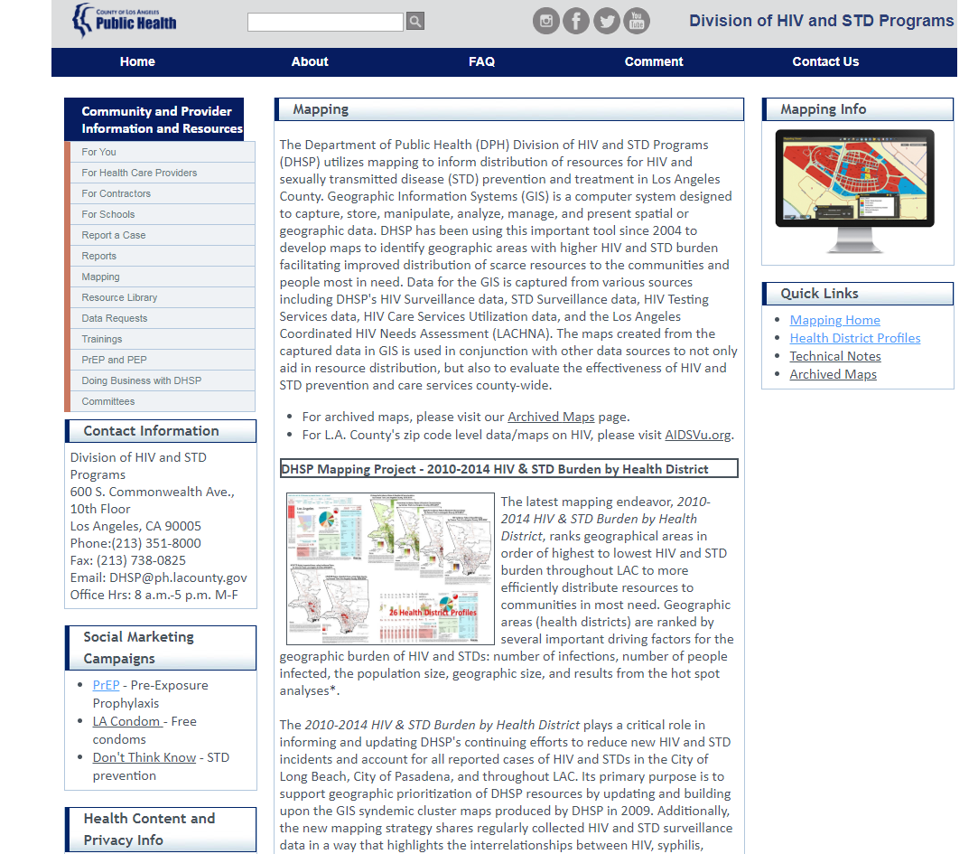
Health Districts on the DHSP Website
Health Districts: http://publichealth.lacounty.gov/dhsp/Mapping.htm

Slide 42
Location of Services
To determine Proposer’s health district visit http://publichealth.lacounty.gov/dhsp/HealthDistricts.htm
To determine which SPA your agency is located in visit http://gis.lacounty.gov/districtlocator/

Slide 43
Availability of Funding
The total estimated funding available for Core HIV Medical Services under this RFP is approximately $20 million annually and will be distributed geographically across LAC based on the existing size of the proposed HIV patient panel and number of average patient visits per clinic.
Funds available for Core HIV Medical Services are distributed as follows:
  $7.5 million annually for AOM Services;
  $7.5 million annually for MCC Services; and
  $5.0 million annually for PSS.

Slide 44

Ryan White Program Eligibility
RWP services provided in LAC are intended solely for clients who lack a third-party payer source and have no ability to pay for HIV medical care services and/or medical care coordination services. RWP is the payer of last resort.

Slide 45

Ryan White Program Eligibility
RWP services are available only for eligible clients who meet all of the following criteria:
  HIV Status: A documented diagnosis of HIV is required once at entry into care.
  Proof of Los Angeles County residency (annually);
  Verification of client's income (annually);
  A voluntarily signed and dated HIPAA-compliant Release of Information form (clients may refuse to sign a Release of Information, but services cannot be refused for otherwise eligible clients) (annually); and
  A signed and dated Limits of Confidentiality form in compliance with state and federal law (annually).
Contractor must conduct a formal eligibility determination within 60-days of enrollment/treatment.

Slide 46
Ryan White Program Eligibility
Ryan White Program Federal Poverty Level Eligibility Guidelines
Family Members | Income | 500% FPL Income*
1 | $15,060 | $72,900
2 | $20,440 | $98,600
3 | $25,820 | $124,300
4 | $31,200 | $150,000
5 | $36,580 | $175,700
6 | $41,960 | $201,400
7 | $47,340 | $227,100
8 | $52,720 | $252,800
For families/households with more than 8 persons, add $5,380 for each additional person.
*All clients with income up to five hundred percent (500%) of the FPL meet RWP income eligibility requirements based on family size. Updated January 2024: Poverty Guidelines | ASPE (hhs.gov).

Slide 47
Selection Process and Evaluation Criteria
Mandy Leung, Contract Analyst
County of Los Angeles Department of Public Health
Division of Contracts and Grants

Slide 48

Proposal Submission Tips
Read and Follow Instructions
  Carefully review all instructions in RFP
  Ensure to include all required documents
with your proposal
  Complete all forms in Appendix B and sign where applicable
  Prepare the budget and budget justification as outlined in budget instructions
  Use only the Excel templates for Budget Worksheets and Proposer’s Background and Experience
  Check Public Health Contracts and Grants Division website for RFP Addendums and Excel templates http://publichealth.lacounty.gov/cg/index.htm

Slide 49
Applying for Service Category(ies)
Read and Follow Instructions
  Select the service category(ies) you are applying for in Appendix B, Required Forms, Exhibit 6 Minimum Mandatory Requirements
  Proposers are permitted to apply for any or all service categories
  Answer the questions applicable for your service category(ies)
  Submit an organizational chart per service delivery site, detailing the positions to be funded for each service category
  Submit resumes for team members for each service category
  Submit budget worksheets and budget justifications (only for MCC Services and PSS) for your service category(ies)

Slide 50
New Insurance Requirement for Contracts
Cyber Liability Insurance
Cyber Liability Insurance is a new requirement on all contracts
No less than $2 million per occurrence and in the aggregate
Refer to Appendix A, Sample Contract, Paragraph 6.8.6

Slide 51
Common Proposal Submission Issues
MINIMUM MANDATORY REQUIREMENTS (MMR)
Adherence to Minimum Mandatory Requirements: Required Forms - Exhibit 6
Select service category(ies) on the form
AOM Services has an additional MMR
FINANCIAL CAPABILITY
Provide a complete set of your organization’s annual financial statements for the last three years.
REQUIRED FORMS/DOCUMENTS
Provide your organization’s Certificate of Good Standing, Statement of Information, and, if applicable, IRS 501(c)(3) Determination Letter
Complete all forms in Appendix B and sign where applicable

Slide 52
Selection Process and Evaluation Criteria
The proposal will be evaluated per RFP Section 9.0, Selection Process Overview
  Stage 1: Adherence to Minimum Mandatory Requirements (Pass/Fail Review)
  Stage 2: Proposal Evaluation (1,050 possible points for each category)
    Proposer’s Qualifications – Proposal Section A (50 possible pts)
    Contractor Alert Reporting Database
    References
    Debarment History and Terminated Contracts
    Financial Capability (30 pts deduction maximum)
    Pending Litigation and Judgments
    Required Forms and Corporate Documents

Slide 53
Selection Process and Evaluation Criteria
  Stage 2: Proposal Evaluation – Continued
    Proposer’s Background and Experience – Section C (250 pts)
    Note: Appendix H is required
    Proposer’s Approach to Providing Required Services – Section D (600 pts for each category)
    Proposer’s Staffing Plan – Section E (50 pts for each category)
    Proposed Budget and Budget Justification – Section F (100 points for each category)
  Stage 3: Final Review and Selection
    Scoring and Ranking for each service category
    A separate score is given for each service category applied

Slide 54
Proposal Deadline
Be mindful of the due date and time
Recommendation: submit a day early to allow for contingencies
Don’t be late!
Notes:
Stress the proposal deadline
So you don’t end up having technical issues that prevent you from submitting proposals on time.

Slide 55

Question & Answer Session
If you have questions, please complete question cards
Submit question cards to facilitator
15 minute break
Please return promptly (meeting will resume on-time)

Slide 56
Question and Answer Session - Continued
Staff will read and respond to question cards
Audience members have the opportunity to ask follow up questions during the Q&A Session
Additional written questions may be submitted by 3:00 pm on 9/17/24 to the contact person specified in RFP Section 8.2 (Proposers’ Questions)
All questions received prior to and during the Proposer’s Conference that need further clarification, as well as all questions submitted by the deadline will be responded to in an addendum to be posted on the County of Los Angeles’ website: http://publichealth.lacounty.gov/cg/index.htm

Slide 57
RFP Timeline - Next Events
Key Event | Due Date /Time | Resource/Reference
Written Questions Due | 3:00 PM on 9/17/24 | RFP Section 1.0
Questions and Answers Addendum Released | 10/1/24 | RFP Section 1.0
Proposals Due By | 3:00 PM on 10/15/24 | RFP Section 1.0

Slide 58
RFP Timeline - Next Events - Continued
Upcoming Addenda
Questions and Answers Addendum: All questions received prior to and during the Proposer’s Conference that need further clarification, as well as all questions submitted by the 3:00 PM, 9/17/24 deadline will be responded to in an addendum. This addendum is scheduled for release 10/1/24. Note: Written questions should be submitted to the County representative identified in RFP Section 8.2 (Proposers’ Questions).
Addendum Release and Posting: Addenda released will be provided via e-mail transmission and also posted on the following link: http://publichealth.lacounty.gov/cg/index.htm

Slide 59
Proposal Submission Guidelines
Proposers are required to submit by email, one electronic copy of the entire proposal in Adobe Acrobat or Portable Document Format (PDF), with no security provisions, by the deadline identified in RFP, Section 1.0, Solicitation Information, to the person and e-mail address identified in RFP, Section 6.2, Contact with County Personnel.
Email subject line must be clearly marked: “Proposal Submission for Core HIV Medical Services for Persons Living with HIV, RFP #2024-008”.
All proposals must be submitted in the prescribed format and order (RFP Section 8.4). Any proposal that deviates from this format may be rejected without review at the Director of Public Health’s sole discretion.

Slide 60
Conclusion
Please ensure that each agency representative has signed/completed the conference attendance sign in sheet.
Thank you for your interest in responding to the CORE HIV MEDICAL SERVICES FOR PERSONS LIVING WITH HIV RFP No. 2024-008
For updates and additional funding opportunities, please visit: http://publichealth.lacounty.gov/cg/index.htm
Thank you!

