Slide 1
CCS Outreach Presentation: Provider Relations Unit (PRU) Module Last update: 09.2016
by
LA County CCS
Department of Public Health

Slide 2
Disclaimers (2)
Disclaimer
The purpose of this module is to provide healthcare providers, Managed Care Plans, and clients and their families with an overview of the CCS Provider Relations Unit (PRU) process. It will provide you with useful information and resources to understand the role of the PRU and how we can assist you. The information contained in this module is solely for the purpose of education and training.
Notes:
Read

Slide 3

PROVIDER RELATIONS UNIT

Slide 4
Provider Relations Unit (PRU)
Assists providers/clients with general claim inquires related to:
Claim Adjudication Challenges and Prevention
Fiscal Intermediary
Share-of-Cost (SOC) Adjudication
Recommendations
Notes:
The Provider Relations Unit assists providers with general claim inquiries related to claim adjudication challenges, such as claim denials; Medi-Cal’s fiscal intermediary and how to obtain assistance; and the SOC process for CCS clients.

Slide 5

CLAIM CHALLENGES AND PREVENTION
Notes:
Claim challenges and prevention

Slide 6
Claim Challenge Prevention
PRU Responsibility:
Preliminary research and Identification of issue
Remittance Advice Detail (RAD) code definition and interpretation
Link to the complete list of RAD codes can be found in the resource section
Limited access on claim history (12 week window)
Notes:
The Provider Relations Unit is responsible for assisting with the preliminary research and identification of claim challenge issues. Depending on the problem, RAD codes can sometimes be confusing. The Provider Relations Unit is responsible for researching and providing guidance on how best to resolve the issue. A complete list of RAD codes can be found in the resource section of this presentation. Please note that the PRU has limited access to view claim history; we are restricted to view claims adjudicated within a 12 week window.

Slide 7
Claim Challenge Prevention
In order to avoid claim denials, the following items require a SEPARATE SAR:
Diabetic Supplies
Restricted, Brand, Compound Drugs.
DMEs or Medical Supplies
If product/service exceeds M/C thresholds
Notes:
Some helpful tips to remember to avoid claim denials is to request a separate SAR for diabetic supplies; restricted, brand or compound drugs; and durable medical equipment and certain medical supplies. You will also need to submit a SAR request and supply justification to a CCS case manager for products and services that exceed Medi-Cal’s billing limit threshold. Once you receive a valid SAR, you can bill for items that exceed the billing limitation.

Slide 8
Claim Challenge Prevention
Helpful Hints to Avoid Claim Challenges:
BIC number submitted on claim must match the SAR
Date of service must fall within the approved dates authorized on the SAR
Inpatient SARs are restricted to hospitals to bill for inpatient stays
Notes:
Following are some helpful hints to avoid claim challenges: 1) the BIC number submitted on the claim must match the SAR; 2) the date of service must fall within the approved dates authorized on the SAR; 3) inpatient SARs are restricted to hospital use to bill for inpatient hospital stays,

Slide 9
Claim Challenge Prevention
Helpful Hints to Avoid Claim Challenges:
The service billed must be authorized either by SCG or individually.
When sharing a SAR, the referring provider’s NPI must be documented in the appropriate field on the claim form
Notes:
4) the service billed must be authorized on the SAR either by Service Code Grouping or individually; and 5) when sharing a SAR, make sure the referring provider’s NPI is documented in the appropriate field on the claim form.

Slide 10
Claim Challenge Prevention
Helpful Hints to Avoid Claim Challenges cont.:
Verify Medi-Cal Eligibility
Prior to Rendering service;
verify eligibility,
Every time!!!
Notes:
Prior to rendering any services, you must always verify eligibility each time a client is seen. This will also let you know whether the client is eligible for straight CCS benefits. The following two slides will demonstrate Medi-Cal eligibility and possible straight CCS eligibility.

Slide 11
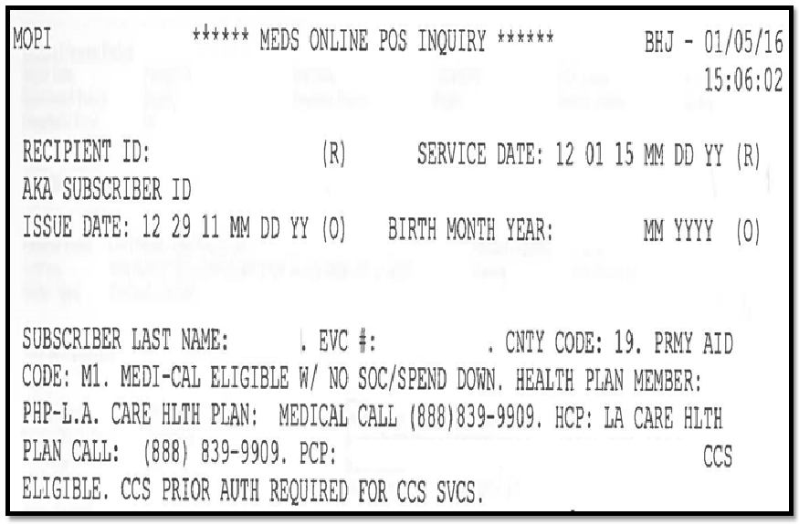
SAMPLE: MEDI-CAL/CCS ELIGIBLE MOPI
Claim Challenge Prevention
Notes:
This is a sample eligibility verification for a client who has Medi-Cal Managed Care and authorized services can be submitted directly to Medi-Cal’s fiscal intermediary.

Slide 12
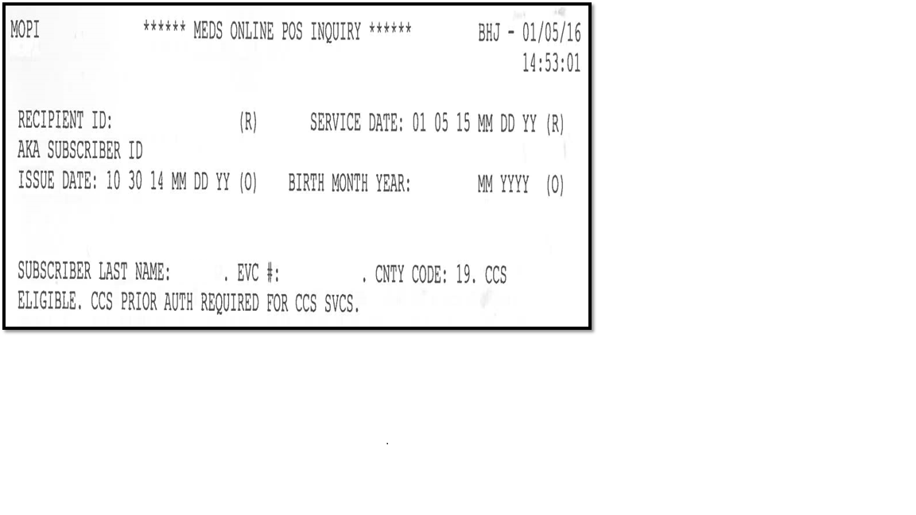
Claim Challenge Prevention
Helpful Hints to Avoid Claim Challenges cont.:
Potential Risk Of Nonpayment!
Notes:
This example does not indicate Medi-Cal eligibility and is a Red Flag which can indicate the client may have lost their Medi-Cal coverage and you should contact our Provider Relations Unit to verify their CCS eligibility status. Depending on the client’s eligibility, you may be able to bill directly to the fiscal intermediary or the client may need to be referred to the Financial Eligibility Unit for further screening.

Slide 13
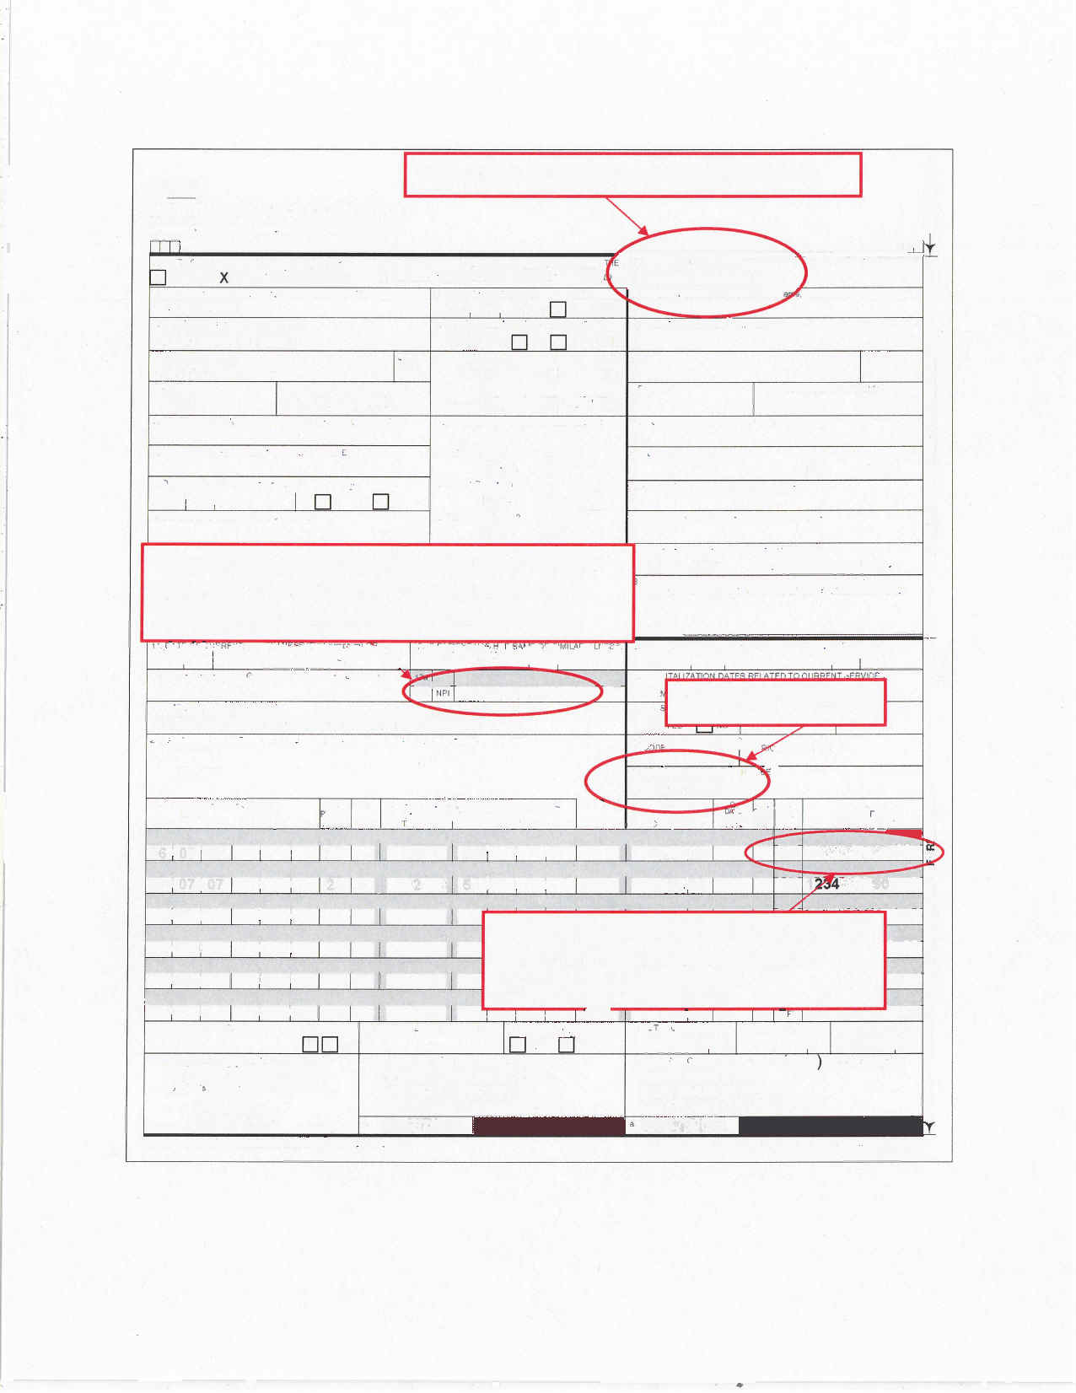
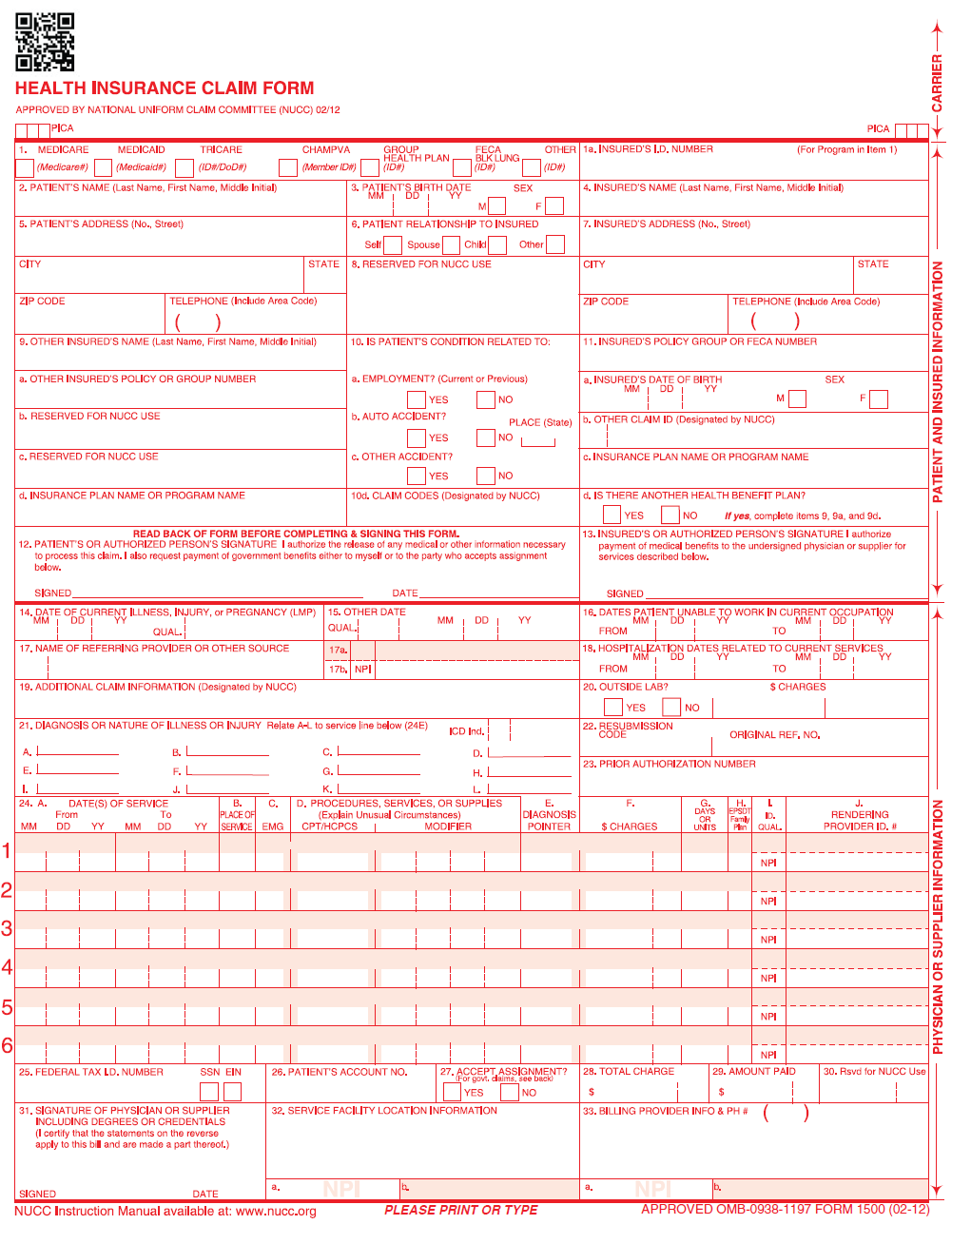
Claim Challenge Prevention
Proper sharing of a SAR – CMS1500
X
90000000A95001
DUE, JANE
1234 MAIN STREET
LOS ANGELES CA
90001 323 555-5555
If the services provided were from a REFERRING
PHYSICIAN’S
SAR, then include both the Name of Referring Provider or Other Source field (field 17) and NPI (field 17b).
SAR number – field 23
JOHN SMITH, M.D.
0123456789
If the rendering provider is billing with a referring physician’s SAR, enter the NPI number of the rendering provider in the Rendering Provider ID Number field 24J.
3439
2860
91234567891
06 07 07 21 42500 AG 200000 1 1234567890
06 07 07 21 42300 51 5000 1 1234567890
250000
250000
DOWNTOWN HOSPITAL
102 FIRST STREET,
LOS ANGELES, CA 900015555
2345678901
JANE DOE
1027 MAIN STREET,
LOS ANGELES, CA 900015555
3456789012
John Smith 06/09/07
Notes:
This is an example of the proper way to share a SAR on a CMS 1500 form. Note the Referring Physician’s name is in Field #17 and the NPI number is in Field #17b. Also note the SAR number that is being shared is in Field #23 and the rendering physician’s NPI is in Field #24J.

Slide 14
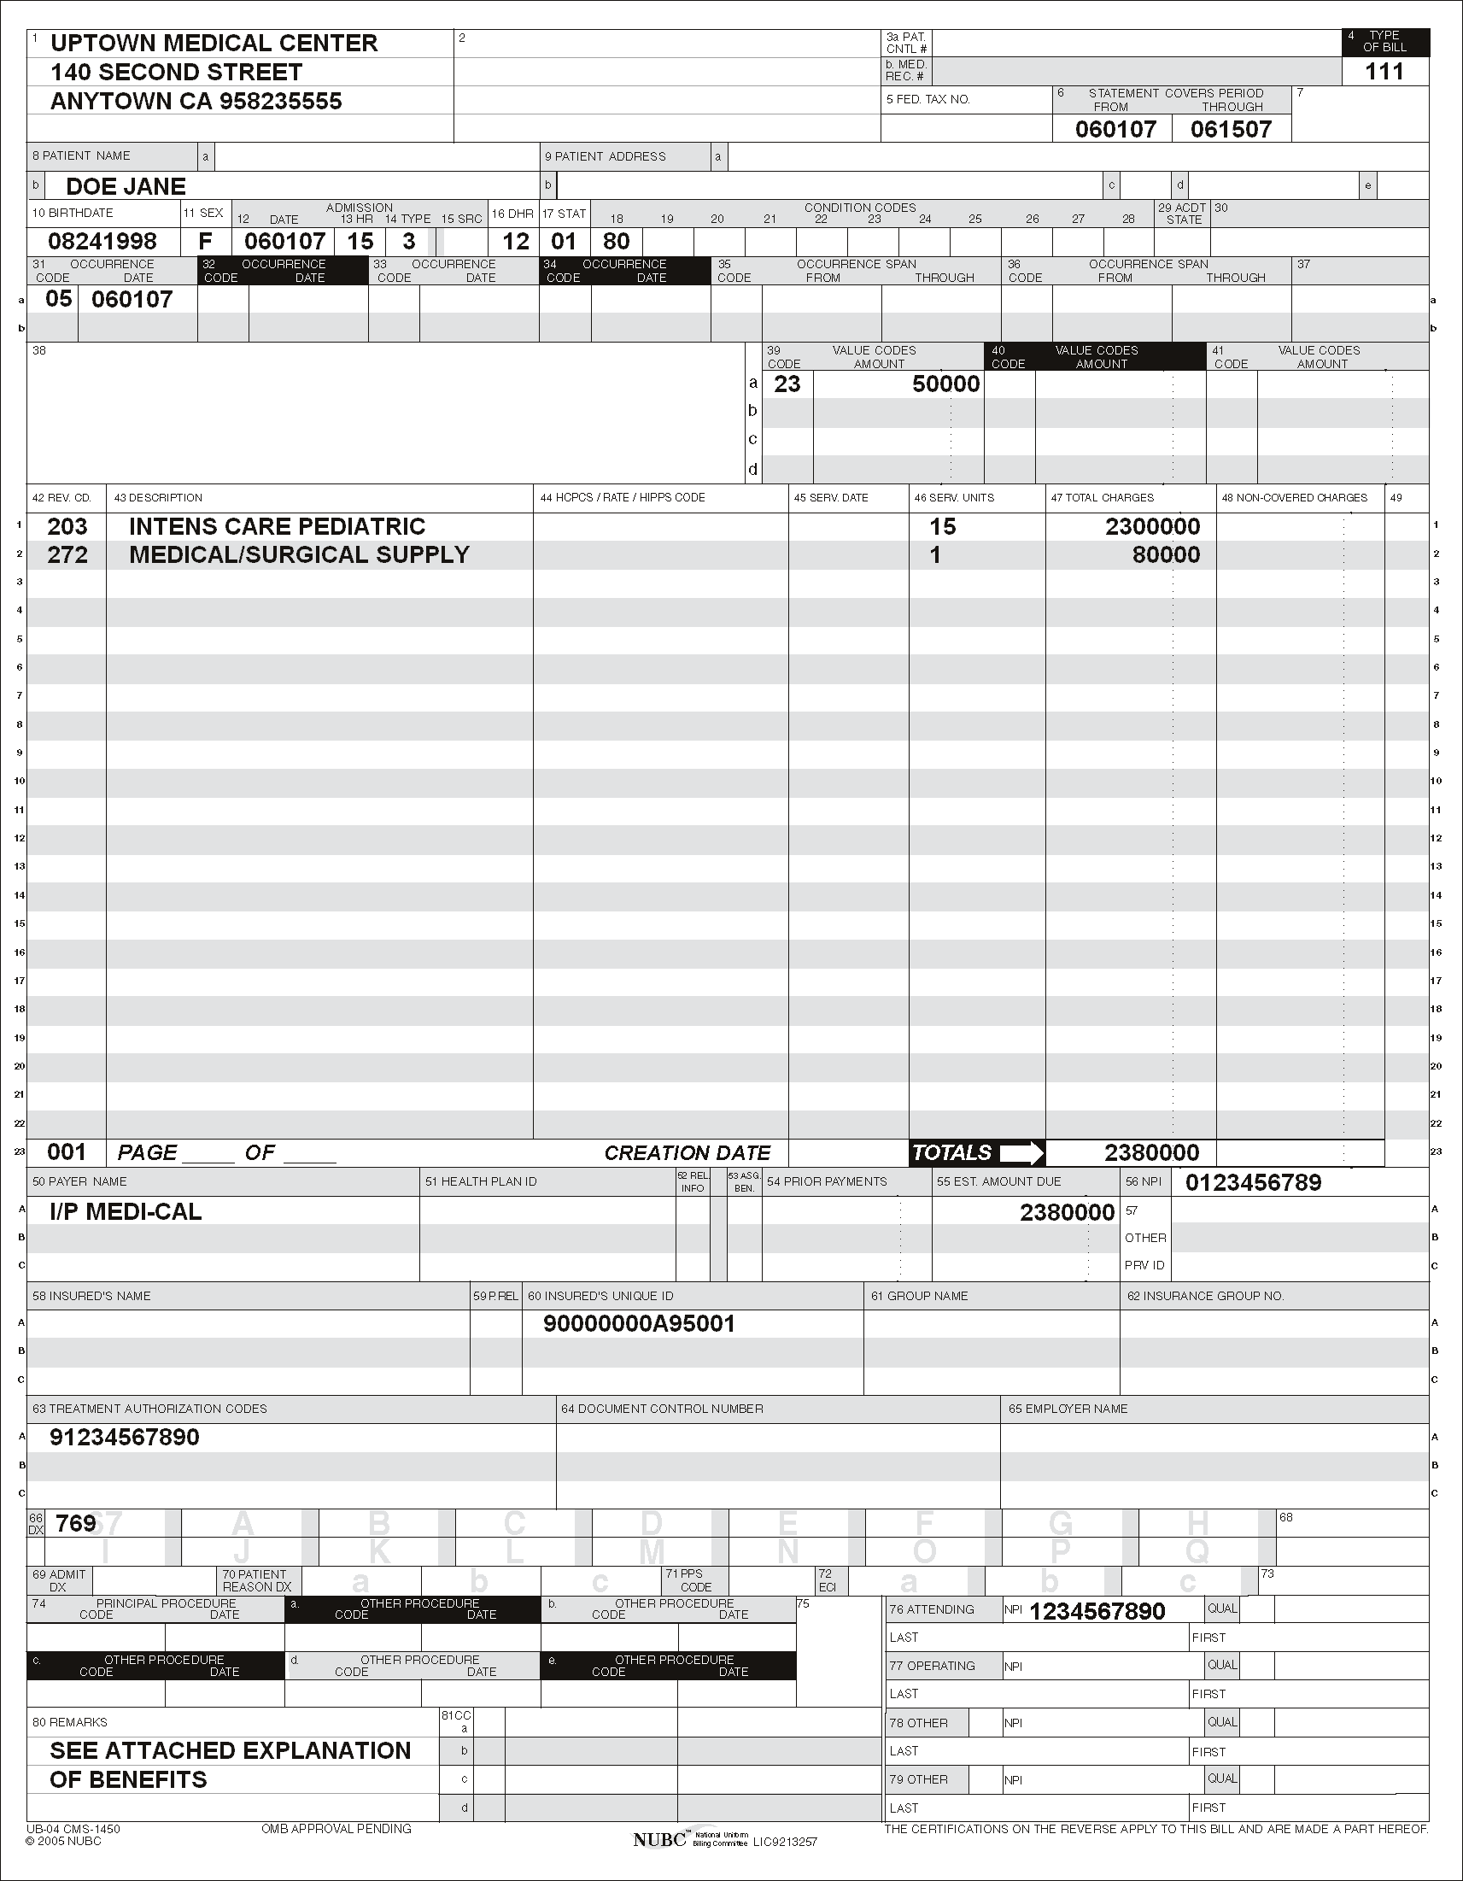
Claim Challenge Prevention
Proper sharing of a SAR – UB04
Rendering provider’s NPI # goes in field 56
Referring provider’s NPI # goes in field 76
SAR number – field 63
Notes:
This example demonstrates the proper placement of the Referring Physician’s NPI # in Field # 76. Also note the SAR # that’s being shared is in Field # 63 and the rendering physician’s NPI # is in Field # 56. The above slides are intended to help you with avoiding basic claims challenges when sharing a SAR.

Slide 15

FISCAL INTERMEDIARY
Notes:
All CCS providers are mandated to be active Medi-Cal providers. Medi-Cal’s Fiscal Intermediary is CCS’ mechanism for payment and is the only way providers will be paid for rendered services. The following slides will provide basic information including how to access a regional representative for complex billing adjudication issues.

Slide 16
Medi-Cal’s Fiscal Intermediary
Call Medi-Cal’s Telephone Service Center (TSC) for assistance with general inquiries:
M/C TSC at 1 800-541-5555
Calling from OUTSIDE of California
1 916-636-1960
Notes:
If you are a client, provider or biller, you can access Medi-Cal’s fiscal intermediary by calling the 800 number listed above. If you are calling from outside of California, you can access the fiscal intermediary by calling the number beginning with 916. The 800 number will not work outside of California, you will receive a busy signal. The telephone service center’s operators can assist with general claim adjudication issues and they are limited a 12 week window to view claim history.

Slide 17
Medi-Cal’s Fiscal Intermediary
M/C Regional Representative Responsibility:
In-depth claim adjudication research
Assists with Medi-Cal’s Fiscal Intermediary internal process
Full access to adjusted claim history
Notes:
Medi-Cal’s Regional Representatives are there to assist with more complex claim adjudication issues. Many times CCS with work in conjunction with the regional representative to better assist you with complex challenges. The regional representative can perform in depth claim adjudication research, assist with the fiscal intermediary’s internal process and they have full access to view claim history beyond 12 weeks.

Slide 18
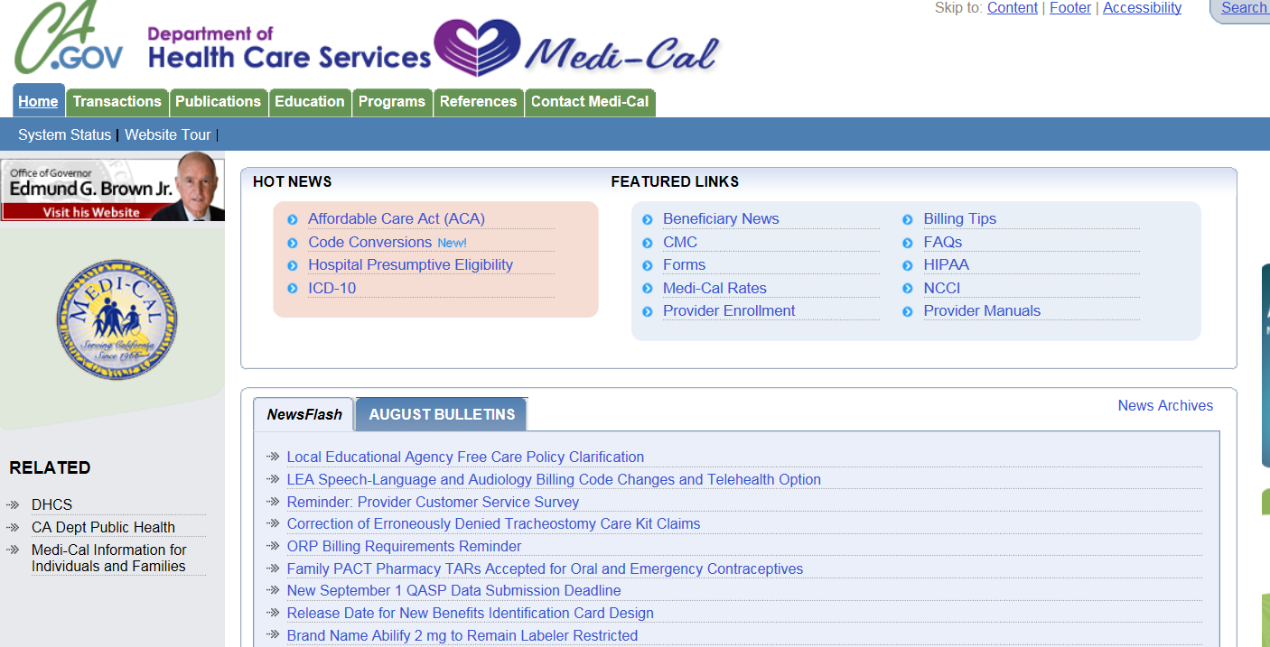
Access & Utilize Regional Representative
Please go to Medi-Cal’s website at: www.medi-cal.ca.gov
Hover the cursor over the “Education” tab.
Click on “Find Regional Representative.”
Notes:
You can find your regional representative by logging onto Medi-Cal’s website at the address listed on the slide. Hover the cursor over the “Education” tab and click on “Find Regional Representative.”

Slide 19
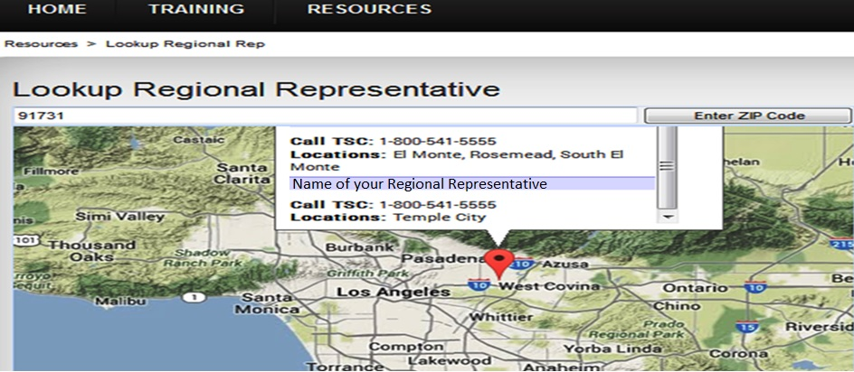
Access & Utilize Regional Representative
Enter zip code of the service address.
Click on “Enter Zip Code” button.
Call TSC and ask to leave a message for your regional representative.
Notes:
When you get to the above screen, enter the zip code of the service address and click on “Enter Zip Code” button. The name of your regional representative will appear in a box like the above sample. Once you have identified your regional representative, you can call the telephone service center and request to leave a message for the regional representative.

Slide 20
Access & Utilize Regional Representative
7. Give a brief description of your challenge
Obtain a “Service Request Number”
Document the time and date of your service request
If you do not receive a call back within 10 business days, contact CCS PRU
When you are contacted by your regional representative, have your Remittance Advice Detail (RAD) available to provide any information they may need in order to assist you with resolution of your challenge
Notes:
You need to be prepared to give the provider’s NPI, full name and address as it appears on the Remittance Advice Detail or RAD you are calling about. You can then give a brief description of your challenge and request a “Service Request Number.” Document the time and date of your service request for future reference. You should receive a call back from your regional representative within 10 days. If you do not receive a call back, you can contact the Provider Relations Unit. When you are contacted by your regional representative, have your RAD available to provide any information they may need in order to assist you with the resolution of your challenge.

Slide 21
Medi-Cal’s Fiscal Intermediary
If you submit hard copy claims, please note the following addresses:
CMS 1500 and Pharmacy- Xerox
PO Box 15700
Sacramento, CA. 95852-1700
UB04 Inpatient - Xerox
PO Box 15500
Sacramento, CA. 95852-1500
UB04 Outpatient - Xerox
PO Box 15600
Sacramento, CA. 95852-1600
IMPORTANT! DO NOT Send to local CCS office!
Notes:
If you submit hard copy claims, please note the listed addresses. Please do not send any hard copy claims to the local CCS office.

Slide 22
Medi-Cal’s Fiscal Intermediary
Computer Media Claims (CMC):
https://files.medi-cal.ca.gov/pubsdoco/CTM_manual.asp
Advantages of CMC:
1-2 Weeks Adjudication vs. up to 8 weeks
Immediate Confirmation
Avoid LOST in transit, delay and/or wrong address
Notes:
It is recommended that you submit electronic claims to the fiscal intermediary. You can get more information at the above link. Some advantages to submitting electronic claim files is the quick turn around time for claims adjudication, approximately 1 -2 weeks; instant confirmation that your claims were received; and you can avoid claims getting lost or delayed.

Slide 23
Medi-Cal’s Fiscal Intermediary
Timeliness Requirement For Claim Reimbursement
0-6 Month = 100%
7-9 Month = 75%
10-12 Month = 50%
Over One Year = Claim Denial for over 1 year RAD code 021 * The Only Exception – Claim submission delays due to CCS eligibility or authorization updates
OVER ONE YEAR CLAIM UNIT
XEROX
PO Box 13029
Sacramento, CA 95813-4029
Notes:
This slide gives you information about Medi-Cal’s claim reimbursement timeliness requirement. As you can see, you have 6 months from the date of service to bill in order to receive 100% reimbursement. There is a penalty for late claim submission, as you can see from the slide 75% reimbursement will be received for claims submitted between 7 – 9 months from the date of service, 50% reimbursement will be received for claims submitted between 10 – 12 months from the date of service and lastly, claims will be denied if they are submitted over 12 months from the date of service. There is an exception for cases in which there was an eligibility or authorization update; these claims can be submitted to the over one year unit with proof of the update and will be reimbursed at 100%.

Slide 24
Medi-Cal’s Fiscal Intermediary
For Pharmacy Assistance Please Call:
LAC CCS-PRU:
1 800-288-4584, option #3
or
Medi-Cal Point of Service (POS) Help Desk:
1 800-427-1295
Notes:
The CCS PRU staff can be the best resource for preliminary research & issue identification but you can also contact Medi-Cal’s Point of Service Help Desk at the number listed on the slide.

Slide 25

SHARE OF COST
Notes:
Share of Cost

Slide 26
Share of Cost
CCS Policy & Procedure states:
Los Angeles County CCS will reimburse the SOC for any CCS client when the Total Cost of the billed services are four times (4X) greater than the client’s SOC amount for each qualified month of service
NOTE: SOC certification gives Full-Scope M/C benefits to clients for the month of service(s)
Notes:
It is CCS’ process to reimburse the SOC for any CCS client when the total cost of the billed services are four times greater than the client’s SOC amount for each qualified month of service. Please note that SOC certification gives full scope Medi-Cal benefits to clients for the month of service.

Slide 27
Share of Cost
Call the CCS-Provider Relations Unit:
Verify straight CCS Eligibility
If not eligible, case will be forwarded to FEU for screening
Notes:
Call the CCS Provider Relations Unit to verify straight CCS eligibility. If the client is not eligible, the case will be forwarded to the Financial Eligibility Unit for screening.

Slide 28
Share of Cost
3. Verify claim amount qualifies for CCS reimbursement on behalf of the client
Qualified: CCS-PRU will work with you to process SOC reimbursement
(Claim $ = 4X > SOC $)
Not Qualified: Call CCS-PRU office to verify eligibility for straight CCS and submit claim directly to Fiscal Intermediary
Notes:
Once it is determined that the client is eligible for straight CCS, the claim amount will be verified to see if it qualifies for SOC reimbursement. To do this, the claim amount must be four times greater than the SOC amount. If it does not meet this criteria, the claim can be submitted to the fiscal intermediary and the SOC does not need to be certified or collected from the client.

Slide 29
Recommendations
For any claim or billing issues contact
PRU @ 1 800-288-4584, option #3
before sending to collections
REMEMBER:
DO NOT bill patients Per Medi-Cal & CCS Regulations and Contracts!
Notes:
Please contact the Provider Relations Unit for any billing issues and remember not to bill clients directly or defer any charges to collections, for services that have been authorized by CCS. The LA County CCS Provider Relations Unit is the best source for preliminary research, issue identification and point of reference to guide you to the appropriate resource for the resolution of your unique issue.

Slide 30
End of Module Thank You

