Slide 1
California Children Services
Case Management Module

Slide 2

Disclaimer
The purpose of this module is to provide healthcare providers, Managed Care Plans, and/or their staff an overview of the CCS referral process. It will provide you with useful information and resources to make appropriate referrals to CCS. The information contained in this module is solely for the purpose of education and training.

Slide 3
Module Objectives
By the end of this section, the provider(s) will be able to:
  Understand the Los Angeles County (LAC)- CCS Referral Process
  Initiate a referral to the CCS Program
  Understand the authorization process
  Understand the Service Code Groupings (SCGs)
  List the different types of status a SAR may have on the PEDI System
Notes:
Module Objectives
By the end of this module, you the provider will be able to:
Initiate a referral to the LA County CCS program
Understand the LA County CCS local office workflow. There are 58 CCS offices throughout California. All the 58 CCS offices follow the same state regulations and program policy guidelines. However, the workflow varies among the local office. Being the LA County CCS is the largest CCS Independent office, our workflow is different.
Understand the authorization process.
Understand how to use the Service Code Groupings, also known as SCGs,
Last, I will discuss the appropriate utilization of SAR forms.

Slide 4

Los Angeles County(LAC)
Referral Process

Slide 5
Referral Process
A referral can be made by anyone, including the family, school, public health nurse, family doctor, facility, medical group, or physician’s specialist.
A SAR Request Form should be used when requesting services from LA County-CCS. These forms can be located on the:
    Medi-Cal Website
    California Children’s Services Website
    Los Angeles County Local CCS Website
Notes:
A referral to the CCS program is defined as a request to the CCS program to authorize medical services for a potential CCS client who is from birth to 21 years of age and is suspected or confirmed with having a CCS-eligible medical condition (refer to the medical eligibility module for some of the medical condition).
Referral to the CCS program can be made several ways by:
Anyone, including the family and school staff
Regional Centers and community programs or clinics
Public Health Nurses, family doctor, or any physician specialist.
Hospitals, outpatient centers, medical centers, or rehabilitation facilities.
A key point to remember is that a referral should be made as early as possible, because CCS does not pay for medical care that is provided before the date of referral (unless the client has full-scope, no share of cost M/Cal and the service was deemed medically necessary).

Slide 6
Referral Process
Referrals must include the following:
  A completed and legible SAR Request Form
  A completed and legible CCS Client Separator Page for each CCS client referred.
  Copy of medical reports, including but not limited to laboratory, radiology, diagnostic test that confirm the suspected eligible condition.
Notes:
When making a referral you must include the following:
A completed and legible SAR request must be filled. A completed SAR request must include client information and CCS paneled provider information and most importantly what is being requested form CCS.
A completed CCS Client Separator Page (our cover fax sheet) for each client being referred. Please do not submit multiple client with one cover sheet. You can locate forms by clicking on the Resource section of this module.
It is imperative that you include copies of medical reports, including but not limited to laboratory, radiology, or diagnostic test that confirm the suspected CCS eligible condition or diagnosis. If you do not attach supporting documentation, you risk delay of services and referral being rejected.
CCS medical eligibility and application process cannot be initiated with an incomplete or ineligible SAR request

Slide 7
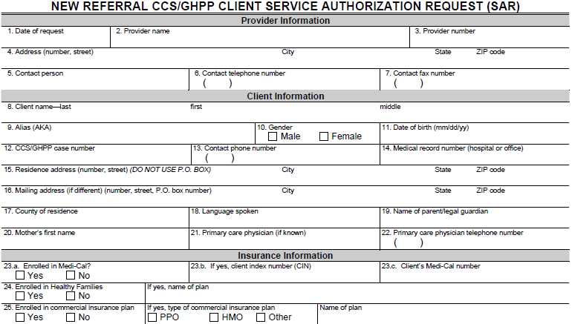
03/8/2016
Dr. Who
1234567890
1200 State Street Pomona, CA 90033
Maggie Joya
909 987-1200
909 987-1223
Mouse Minnie
x
07/08/1994
1234567
323 338-1234
161 W. 14th Street Pomona Ca 90003
Los Angeles
Mickey Mouse
Daisy
x
92704529C

Slide 8
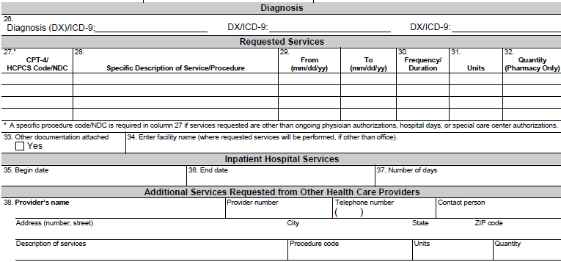
C16.1
E10.1
What are you requesting from CCS?
SCG, HCPCS/CPT code, Medication,
Medical supplies, DMEs, etc….
7/5/16
x
Pomona Valley Medical Ctr NPI #1407813660
7/5/2016
7

Slide 9
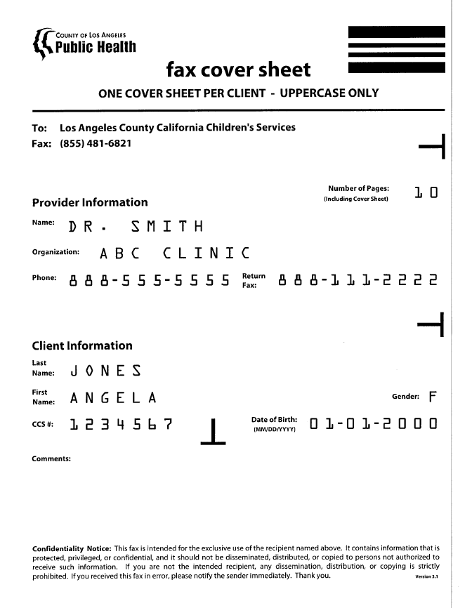

Slide 10
Referral Process
Provider(s) may submit the completed SAR request and supporting documents by:
  Faxing information to 1-855-481-6821.
  Allow 7 to 10 business days for CCS to process new referral request.
  Avoid faxing referrals multiply times.
Notes:
Once provider has gathered all information, to complete the referral you will have to:
Fax the completed SAR form and medical reports to 1-855-481-6821.
Allow 7 to 10 business days for the local office to process all new referral request. Note that extensions or renewal request may take longer to process.
It is important that you avoid re-faxing the same referral multiply times. For one, the system will keep creating a backlog of documents. Re-faxing will duplicate request and delay response from the nurse case manager.
If you have any questions regarding SAR request or referrals, please contact one of our nursing agents Monday thru Friday, from 8 to 4:30pm, at 1-800-288-4584, press option #7.

Slide 11
Referral Process
Provider(s) may also submit SAR request via e-SAR application:
  Effective September 12, 2016 provider may submit service request via e-SAR application.
  The e-SAR application is basically, another method for submitters (aka Trading Partners) to submit service request to CCS Counties.
  For additional information, go directly to the CCS website.
Notes:
Once provider has gathered all information, to complete the referral you will have to:
Fax the completed SAR form and medical reports to 1-855-481-6821.
Allow 7 to 10 business days for the local office to process all new referral request. Note that extensions or renewal request may take longer to process.
It is important that you avoid re-faxing the same referral multiply times. For one, the system will keep creating a backlog of documents. Re-faxing will duplicate request and delay response from the nurse case manager.
If you have any questions regarding SAR request or referrals, please contact one of our nursing agents Monday thru Friday, from 8 to 4:30pm, at 1-800-288-4584, press option #7.

Slide 12





1
Referral Faxed and
Received at Local Office
If rejected, the provider will get a Referral Transmittal Notice with a Tracking Number
2
REDs Team will review all New and Closed Client SAR Request
If approved, referral sent to Registration Unit and for new clients a permanent CCS number will be issued
3
Document Imaging Unit will create an e-Chart for client
4
Medical Case Management Team will review incoming request and disposition accordingly
5
Provider(s) will be able to access SAR information on the PEDI System

Slide 13
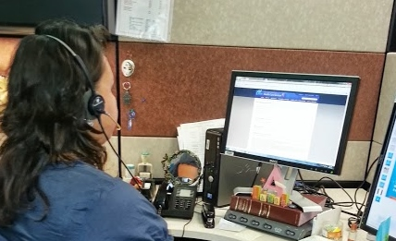
Authorization Process

Slide 14
Authorization Process
The CCS program requires authorization for health care services related to a CCS client’s CCS-medically eligible condition.
Services may be authorized for varying length of time during the CCS client’s program eligibility period (usually one year, if open for treatment services).
The referring provider(s) must indicate what type of services and who the services should be authorized to. If this information is omitted, a delay in authorizing services may occur.
Notes:
When making a referral you must include the following:
A completed Service Authorization Request form, also known as a SAR form. You can locate forms by clicking on the Resource section of this module.
A completed CCS Client Separator Page (our cover fax sheet) for each client being referred. Please do not submit multiple client with one cover sheet. You can locate forms by clicking on the Resource section of this module.
It is imperative that you include copies of medical reports, including but not limited to laboratory, radiology, or diagnostic test that confirm the suspected CCS eligible condition or diagnosis. If you do not attach supporting documentation, you risk delay of services and referral being rejected.

Slide 15
Authorization Process
CCS requires that all physicians be CCS-paneled or facility’s be CCS-approved in order to be authorized to provide services to CCS client.
If a provider or facility is not CCS approved or paneled, the CMS-Net SAR system will not allow user to issue a SAR authorization as requested.
For additional information on applying for CCS paneling, visit our state CMS-CCS website. You may apply on-line.
Notes:
When making a referral you must include the following:
A completed Service Authorization Request form, also known as a SAR form. You can locate forms by clicking on the Resource section of this module.
A completed CCS Client Separator Page (our cover fax sheet) for each client being referred. Please do not submit multiple client with one cover sheet. You can locate forms by clicking on the Resource section of this module.
It is imperative that you include copies of medical reports, including but not limited to laboratory, radiology, or diagnostic test that confirm the suspected CCS eligible condition or diagnosis. If you do not attach supporting documentation, you risk delay of services and referral being rejected.

Slide 16

Service Code Groupings
SCG’s

Slide 17
Service Code Groupings (SCGs)
SCGs are groups of reimbursable codes that are authorized to a CCS-approved provider(s) or approved providers for the care of a client’s CCS-medically eligible condition.
An SCG contains a listing of the codes that allow the provider to provide care for the client’s CCS-medically eligible condition without needing to obtain repeated single authorizations for services.
The SCGs were designed to remove barriers for accessing care for CCS clients.

Slide 18
Service Code Groupings (SCGs)
There are 12 inclusive SCGs and 1 excluded SCG that a provider may use when requesting services.
To access a list of what is included in the 12 SCGs, go directly to Medi-Cal website or click on the link in the resources section of this module.
To access information on SCG 51 (excluded SCG); refer to Numbered Letter: 02-0510 on our CCS website or click on the link in the resources section of this module.

Slide 19
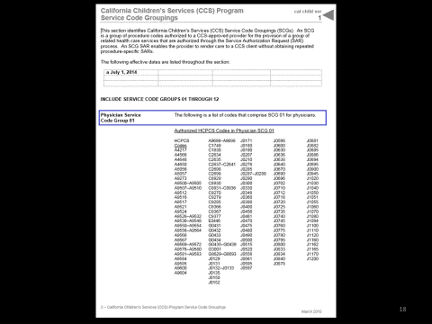
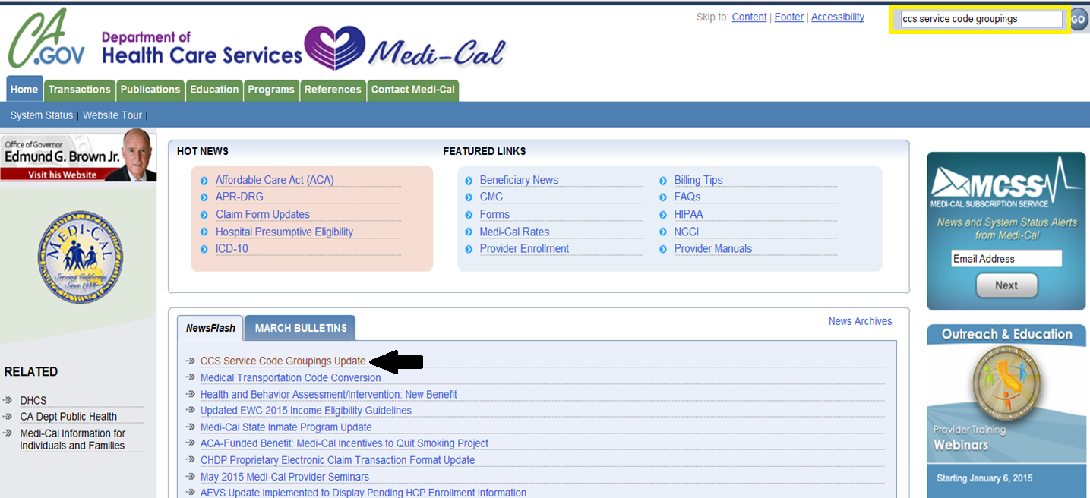
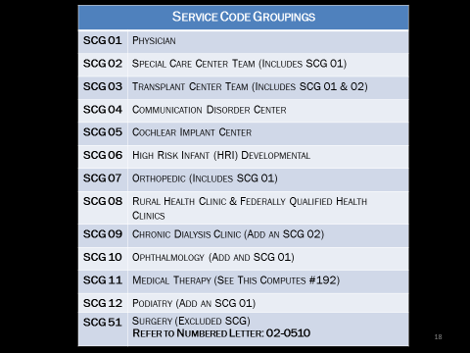
Service Code Groupings (SCGs)
There are 12 inclusive SCGs and 1 excluded SCG that a provider may use when requesting services.
To access a list of what is included in the 12 SCGs, go directly to Medi-Cal website or click on the link in the resources section of this module.
To access information on SCG 51 (excluded SCG); refer to Numbered Letter: 02-0510 on our CCS website or click on the link in the resources section of this module.

Slide 20

SCG 01:
Physician Grouping

Slide 21
SCG 01: Business Rules
SAR is issued to the CCS paneled provider’s NPI number or the CCS-approved facility’s outpatient NPI number.
SAR can be modified to add additional CPT or HCPCS codes not listed under the current SCG 01 grouping.
SAR can be shared with other healthcare provider for services related to CCS medically eligible condition.

Slide 22
SCG 01: Covered Services
Professional Services
Some specialty services or procedures
Laboratory Services
Radiology Services
Emergency room services, r/t the CCS-medically eligible condition.
Pharmacy products or medication r/t the CCS-medically eligible condition.

Slide 23

SCG 02:
Special Care Center

Slide 24
SCG 02: Business Rules
SAR issued to the CCS-approved SCC directory number (i.e. 7.05.08).
SAR includes the full-range of codes that are found in the SCG 01 grouping.
No individual CPT or HCPCS codes can be added to SAR.

Slide 25
SCG 02: Covered Services
Inpatient SCC: Covers physician and professional services related to inpatient stay for clients admitted to a NICU, PICU or Acute Rehabilitation setting.
Outpatient SCC: Covers comprehensive follow-up with multidisciplinary and multispecialty team services. It allows centers to bill for specialty services (chart review, team conference, etc.…).

Slide 26

Inpatient Services

Slide 27
Inpatient Services
There are two components to inpatient services:
  SAR #1: Hospital
    Issued to the CCS-approved hospital’s NPI number. This SAR covers room revenue and ancillary services only.
  SAR #2: Professional Services
    Issued to the CCS-paneled physician - or - SCC team responsible for the care of the hospitalized CCS client.

Slide 28

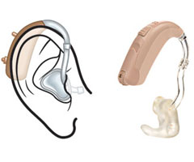
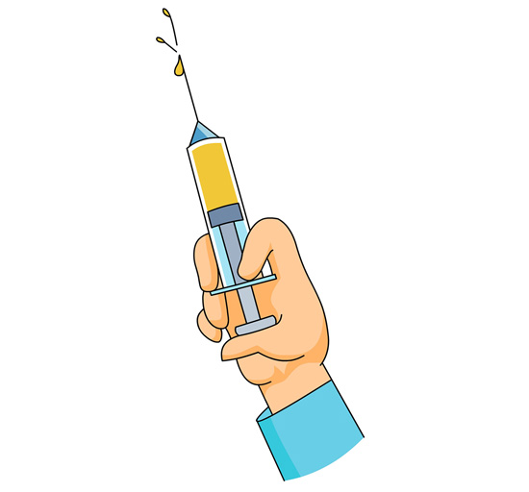


Services Requiring a
Product-Specific SAR

Slide 29
Product-Specific Items
The following items are not covered under any of the existing SCGs:
Medical Supplies or Durable Medical Equipment: over the M/Cal billing limit.
Pharmacy Products:
  Diabetic Supplies
  Restricted Drugs
  Brand Name
  Blood Products
Medical Transportation
Home Health
Surgery
Inpatient Services
Non-M/Cal Benefit Items or Services
Hearing Aids

Slide 30

Provider Electronic Data
Interchange (PEDI) System

Slide 31
PEDI System
A web-based tool that enables approved CCS providers and M/Cal Managed Care Plans to electronically access:
  Status of SAR request and authorizations
  Print authorizations, denials, reports, and correspondence
  Access to referral tracking

Slide 32
PEDI System
Pending: (Invalid)
  Waiting to be released ∼or ∼ Request in Review
  Pending Financial Screening
  Provider cannot bill for services
Authorized: (Valid)
  Services approved
  Provider may bill for services
Authorized (M)odified: (Valid)
  A change made to original SAR

Slide 33
PEDI System
Canceled: (Valid or Invalid)
  Valid≈ If services rendered between begin and end date of canceled SAR, you may bill for services☺
  Invalid≈ If services canceled on the same date of services being request, you may NOT bill for services☹
Denied: (Invalid)
  Cannot be used to bill for services
  Notice of Action Issued

Slide 34
PEDI System
Download PEDI Application:
  http:/www.dhcs.ca.gov/services/ccs/cmsnet/Pages/CMSNetProviderEDI.aspx
  Application package can be mailed:
  Attention: Management Information Systems
  Department of Public Health-Children’s Medical Services
  9320 Telstar Ave., Suite 226
  El Monte, CA 91731
Help Desk:
  626-569-6630 or 1-866-685-8449

Slide 35
Contact Information
If you have any questions regarding SAR request or referrals, please contact one of our nursing agents at: 1-800-288-4584, press option #7

Slide 36
End of Case
Management Module

